Slide 1

Capstone Project – Final: Review – 2 on Secure Data Sharing in Cloud Using Attribute-Based Encryption (ABE)
Presented by the Batch No. : CS - 03
Patan Ahammad Sahid - BU22CSEN0400031 (TL)
Mohammed Mehraj Ahmed - BU22CSEN0400125 (TM-1)
Ranjith Gowda B M - BU22CSEN0400258 (TM-2)
Under the Guidance of
Ms. Nida Kousar G
Assistant Professor
Department of Artificial Intelligence & Data Science
GITAM School of CSE, GITAM (Deemed to be University),
Bengaluru, Karnataka, INDIA.

Slide 2
CONTENTS
Recap of Capstone Project Final Review-1
Problem Statement
Objectives and Project Workflow
Feedback from Guide/Reviewers and actions taken after Capstone Project Final Review–1
Testing Strategy & Validation
Results, Analysis & Discussion
Conclusion
References

Slide 3
Problem Statement
Loss of Data Confidentiality in Cloud Storage When sensitive data is stored on third-party cloud platforms, users must trust the service provider with their files. This results in loss of control over data confidentiality and increases the risk of data breaches and insider misuse.
Inadequate Access Control Mechanisms Existing cloud systems do not provide fine-grained, user-defined access control. Data owners cannot precisely control access based on user attributes such as role, department, or clearance.
Centralized Access Authorization Cloud storage systems use centralized authorization, creating a single point of failure. A single authority can grant or deny access, making the system vulnerable to insider threats and unauthorized access.

Slide 4
Objectives
Objective–1: Ensure confidentiality of shared files Encrypt every uploaded file using AES‑256 before storing, so data remains protected at rest and during transfer.
Objective–2: Provide fine‑grained, attribute‑based access control Define “who can access” each file using attribute policies (AND/OR rules) based on user attributes like role, department (dept), and clearance.
Objective–3: Enforce decentralized approval before decryption Require a blockchain-based threshold approval (4‑of‑7 authorities) for each access request so no single party can grant access alone.

Slide 5
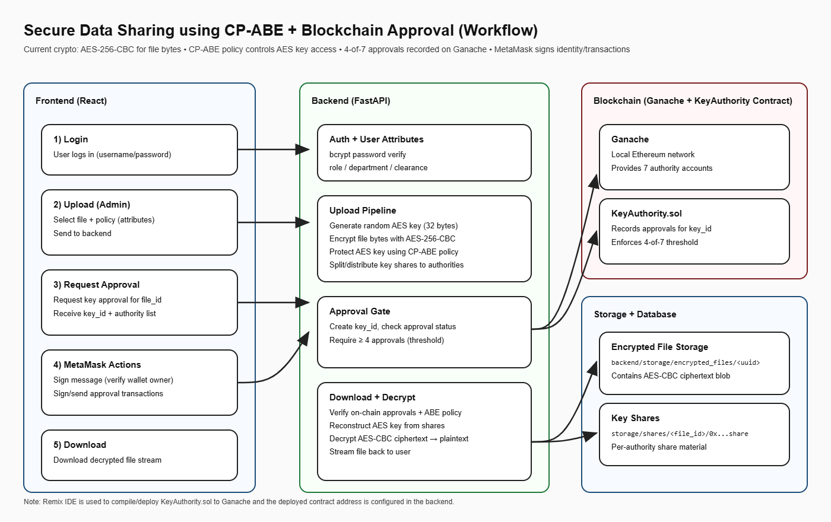
Design Strategy
Project Workflow

Slide 6
Feedback from Guide/Reviewers and actions taken after Capstone Project Final Review–1
Feedback from Guide/Reviewers
Asked to clearly explain how AES encryption algorithm is working to protect uploaded files.
Asked how access control is enforced so that unauthorized users cannot download files.
Asked to justify the need for blockchain-based approval instead of a centralized authority.

Slide 7
Actions taken
Clearly explained and documented how AES-256 encryption works, including how files are encrypted before storage and decrypted after authorized access.
Implemented attribute-based access control (AND/OR policies) using user attributes like role, department, and clearance, and ensured that files can only be downloaded when the policy conditions are satisfied..
Justified and implemented a blockchain-based threshold approval system (4-of-7 authorities) to ensure secure, decentralized access instead of relying on a single central authority.

Slide 8
Testing Strategy & Validation
Unit Testing
Tested individual modules (encryption, API endpoints, blockchain connection)
Verified correct input/output behavior
Integration Testing
Checked interaction between frontend, backend, MongoDB, and blockchain
Ensured file upload → encryption → storage → retrieval works properly
System Testing
Tested complete workflow from upload to download
Verified access control based on user attributes

Slide 9
Testing Strategy & Validation
Blockchain Validation
Verified smart contract communication with Ganache
Tested 4-of-7 approval mechanism
Security Testing
Ensured files are stored encrypted (not plaintext)
Verified unauthorized users cannot access files
Performance Metrics
File upload/download response time
Approval processing time
System stability under multiple requests

Slide 10
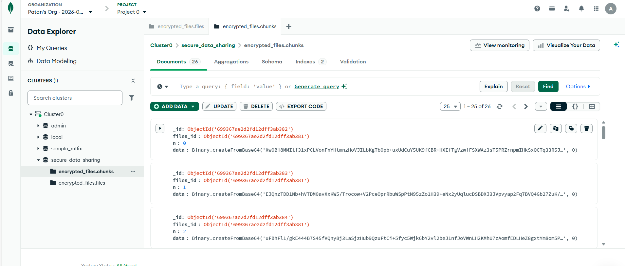
Ensured files are stored encrypted (not plaintext)

Slide 11
Results, Analysis & Discussion
The system successfully performs secure file sharing using encryption and blockchain
Files are stored in encrypted form (MongoDB GridFS), not plaintext .
Access is allowed only when:
User attributes match policy
Required approvals (4-of-7) are completed
MetaMask verification is done
Analysis:
Ensures data confidentiality
Prevents unauthorized access
Eliminates single-point failure using decentralized approvals

Slide 12
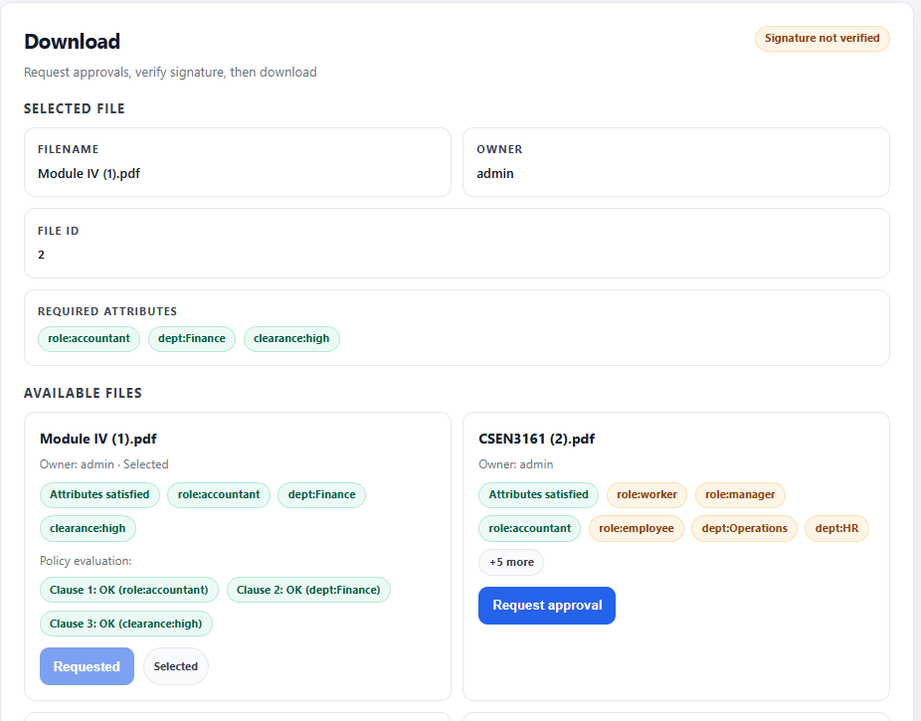
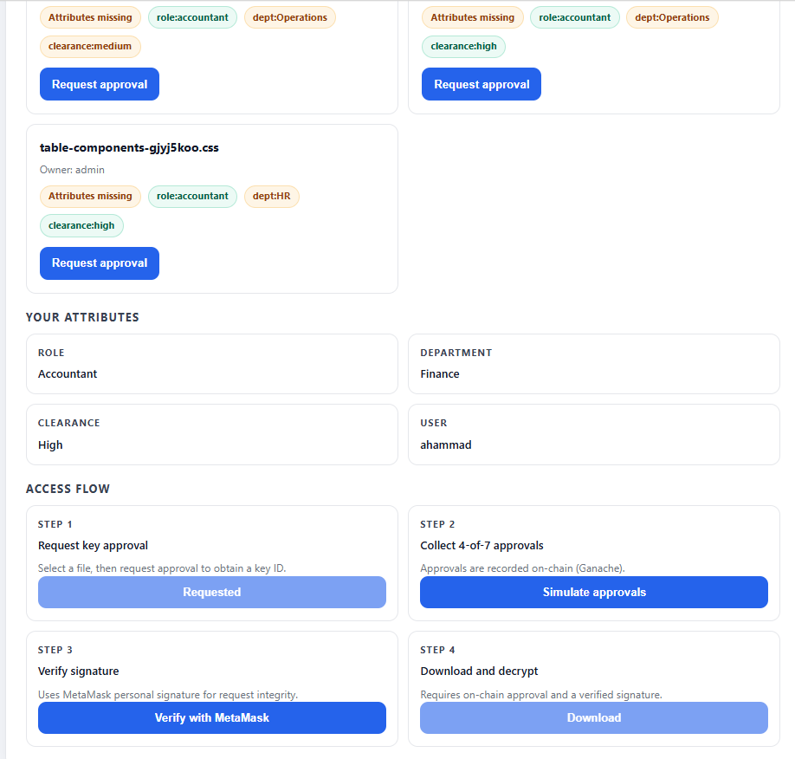

Slide 13
Conclusion
Summary of project
In this project, we built a secure data sharing system using encryption and blockchain .
Files are encrypted before storage, so data is always protected .
Access is controlled using user attributes, not just login .
Multiple approvals (4 out of 7) are required before giving access .
The full process works smoothly from upload to download .

Slide 14
Expected Outcomes / Impact
Data remains secure even if storage is accessed
Only the right users can access files
No single person has full control, which improves trust
MetaMask adds an extra layer of user verification
This system can be useful in areas like organizations, healthcare, and academic system

Slide 15
Conclusion
The project successfully ensures confidentiality by encrypting every uploaded file using AES‑256 before storage, keeping data protected at rest and during transfer.
It provides fine‑grained access control using attribute‑based policies (AND/OR rules), so only users whose role, dept, and clearance satisfy the policy can decrypt the file.
It enforces decentralized control by requiring blockchain threshold approvals (4‑of‑7 authorities) before decryption, preventing any single party from granting access alone.

Slide 16
References
[1] Li, M., Yu, S., Zheng, Y., Ren, K., & Lou, W. (2012). Scalable and secure sharing of personal health records in cloud computing using Attribute-Based Encryption. IEEE Transactions on Parallel and Distributed Systems, 24(1), 131–143. https://doi.org/10.1109/tpds.2012.97
[2] Gajmal, Y., More, P., Jagtap, A., & Kale, K. (2024). Access control and data sharing mechanism in decentralized cloud using blockchain technology. Journal of Autonomous Intelligence, 7(3). https://doi.org/10.32629/jai.v7i3.1332
[3] Hwang, Y., Kim, S., Seo, D., & Lee, I. (2022). An SKP-ABE scheme for secure and efficient data sharing in cloud environments. Wireless Communications and Mobile Computing, 2022, 1–17. https://doi.org/10.1155/2022/1384405
[4] Ghoubach, I. E., Benabbou, R., & Mrabti, F. (2016). FP2E: Flexible, effective and privacy preserving cloud data sharing scheme. Cloud, 7–12. https://doi.org/10.1109/cloudtech.2016.7847691
[5] Zhao, M., Chen, H., Yao, Y. et al. Lattice-based ABE with multi-ciphertext equality test in cloud computing. J. King Saud Univ. Comput. Inf. Sci. 37, 38 (2025). https://doi.org/10.1007/s44443-025-00047-w

